Slide 1
Cloud-based Bug Tracking and Resolution.
Presenter name:
K. Tejaswi(192110052)
CH. Sudeepthi(192111157)
U. Ramya(192210075)
Guide Name:
Mr.Madhusundar

Slide 2
ABSTRACT
The unique challenges posed by bug tracking in cloud computing environments, such as distributed architectures, virtualization, scalability issues, and dynamic resource provisioning.
It discusses various bug tracking methodologies including manual tracking, automated monitoring, and machine learning-based anomaly detection.
It indicates a comprehensive approach to understanding the existing landscape of bug tracking practices.
It mentions an analysis of popular bug tracking tools and platforms used in cloud environments, emphasizing their features, strengths, and limitations.
It suggests an examination of practical tools and technologies used in real-world scenarios.

Slide 3
INTRODUCTION
This highlights the increasing prevalence of cloud computing and its implications for software complexity.
Emphasizes the critical importance of efficient bug tracking in ensuring reliability, performance, and security of cloud-based applications.
Outlines objectives of conducting a thorough review of bug tracking methodologies and tools specific to cloud computing environments.
Introduces unique challenges posed by cloud computing, such as distributed architectures, virtualization, scalability concerns, and dynamic resource provisioning.
Provides a preview of the proposed framework to address these challenges and improve bug tracking in cloud environments.

Slide 4
OBJECTIVE
To identify the unique challenges posed by cloud computing, such as distributed architectures, virtualization, scalability issues, and dynamic resource provisioning, in the context of bug tracking.
To analyse various bug tracking techniques, including manual tracking, automated monitoring, and machine learning-based anomaly detection, and assess their applicability and effectiveness in cloud environments.
To evaluate popular bug tracking tools and platforms used in cloud computing, highlighting their features, strengths, and limitations.
To propose a novel framework for enhancing bug tracking in cloud computing environments, integrating proactive bug detection mechanisms, real-time monitoring, automated incident response, and intelligent analytics.

Slide 5
EXISTING SYSTEM
The existing system refers to the current state of bug tracking methodologies and tools in cloud computing environments.
It encompasses a variety of bug tracking techniques, including manual tracking, automated monitoring, and machine learning-based anomaly detection.
Existing bug tracking tools and platforms used in cloud environments are evaluated, considering factors such as features, strengths, and limitations.
Challenges inherent in the existing bug tracking system within cloud computing are identified, such as difficulties in tracking bugs across distributed architectures, scalability issues, and dynamic resource provisioning.
The existing system may lack comprehensive coverage, real-time monitoring capabilities, or efficient incident response mechanisms, leading to delays in bug detection and resolution.

Slide 6
RESEARCH GAP
Despite the increasing prevalence of cloud computing and its inherent complexities, there is a noticeable gap in the literature regarding comprehensive reviews of bug tracking methodologies and tools specifically tailored to cloud computing environments.
Existing research often focuses on general bug tracking practices or specific aspects of cloud computing, but there is a lack of integration between the two domains, leaving a gap in understanding how cloud-specific challenges impact bug tracking processes.
While there are numerous bug tracking tools available, there is limited research that systematically evaluates their effectiveness, scalability, and suitability for cloud environments, leaving organizations with limited guidance on selecting the most appropriate tools for their needs.
There is a research gap in developing proactive bug detection mechanisms and real-time monitoring solutions tailored to these dynamic environments.

Slide 7
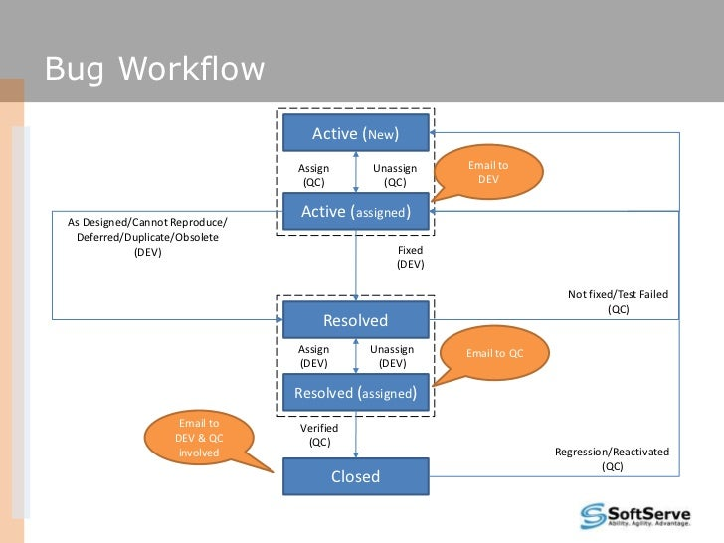
ARCHITECTURAL DIAGRAM

Slide 8
EXPLANATION
Bug Tracking Tools: These are software applications used by organizations to keep track of bugs or issues in their software systems. These tools help teams identify, prioritize, and resolve issues efficiently.
Limited Research: There hasn't been much investigation or study conducted to thoroughly examine bug tracking tools. This means that there's a lack of comprehensive analysis or evaluation of these tools.
Effectiveness: This refers to how well a bug tracking tool performs its intended function. It includes factors like how accurately it identifies bugs, how easy it is to use, and how well it integrates with existing workflows.
Scalability: This relates to the ability of a bug tracking tool to handle larger tasks or a growing number of bugs as the software system becomes more complex or experiences increased usage.
Suitability for Cloud Environments: Cloud computing environments have specific characteristics, such as distributed architecture and dynamic resource provisioning. Bug tracking tools need to be evaluated to determine if they are well-suited to operate effectively within these cloud environments.

Slide 9
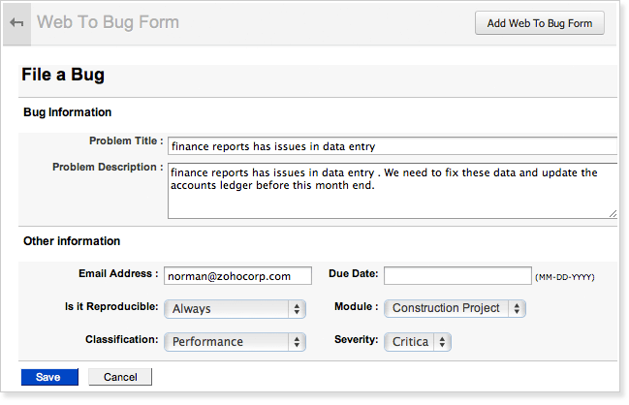
IMPLEMENTATION

Slide 10
RESULTS AND DISCUSSION
RESULT: The bug tracking system implemented using Zoho Page successfully allows users to submit bugs through a user-friendly form. The bug list is dynamically displayed, showing all reported bugs along with their relevant details such as title, description, severity level, and status updates. Email notifications are sent to relevant team members whenever a new bug is reported or the status of a bug is updated.
Discussion:
User Experience: The bug submission form provides an intuitive interface for users to report bugs effectively.
Efficiency: With the bug list dynamically displayed on the page, team members can quickly access and prioritize bugs based on their severity and status.
Transparency and Accountability: By displaying the status updates of reported bugs, the bug tracking system promotes transparency within the team.
Collaboration: The email notifications feature facilitates collaboration among team members by keeping them informed about new bug reports and updates.

Slide 11
CONCLUSION
The implementation of a bug tracking system using Zoho Page presents a valuable asset for organizations striving to enhance software quality and streamline bug resolution processes.
Through the user-friendly bug submission form and dynamically displayed bug list, the system offers a seamless experience for users and developers alike.
Email notifications ensure timely communication and collaboration among team members, fostering transparency and accountability in bug resolution efforts.
The scalability and integration capabilities of the bug tracking system enable it to adapt to the evolving needs of the organization, accommodating changes in project scope and requirements.
By leveraging Zoho's suite of applications, including Zoho Forms, Zoho Creator, and Zoho CRM, the system benefits from enhanced functionality and flexibility, further optimizing bug reporting, data management, and communication processes.

Slide 12
REFERENCES
Zhang, Z., Huang, L., Yuan, D., & Mei, H. (2018). On Bug Characteristics in Cloud Computing Systems: An Empirical Study. IEEE Transactions on Software Engineering, 44(6), 572-588. DOI: 10.1109/TSE.2017.2726359
Dhama, S., & Chana, I. (2017). A Review on Bug Tracking System in Cloud Computing. International Journal of Engineering and Computer Science, 6(7), 21847-21851.
Alshammari, R., & Nurcan, S. (2016). A Bug Tracking System for Cloud Computing Environments. In Proceedings of the International Conference on Software Engineering and Service Science (ICSESS), 240-243. DOI: 10.1109/ICSESS.2016.7810433
Li, Z., Yan, S., Wang, H., & Du, X. (2016). A Novel Cloud-Based Bug Tracking System for Mobile Applications. In Proceedings of the International Conference on Cloud Computing and Big Data (CCBD), 140-144. DOI: 10.1109/CCBD.2016.80

Slide 13


